Slide 1
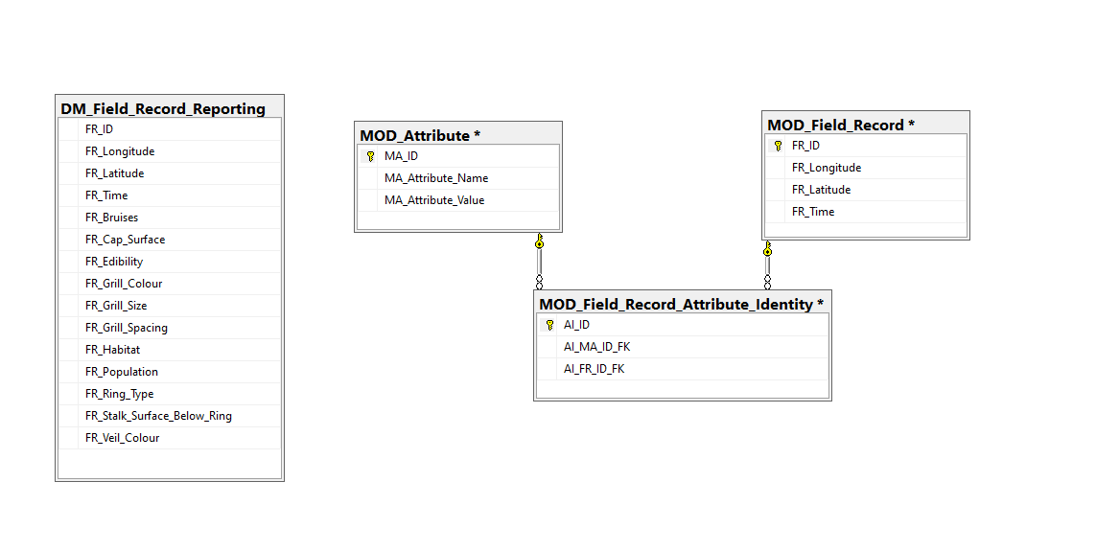
AI_MA_ID_FK = MA_ID
AI_FR_ID_FK = FR_ID
Standalone Reporting Table

